Slide 1
KPI
INFOGRAPHICS
Here is where your presentation begins

Slide 2
KPI INFOGRAPHICS
60%
50%
40%
Venus has a beautiful name, but it’s hot
Mercury is the closest planet to the Sun
Despite being red, Mars is a cold place
60%
MERCURY
75%
MARS
70%
NEPTUNE

Slide 3
KPI INFOGRAPHICS
MERCURY
NEPTUNE
Mercury is the closest planet to the Sun
Neptune is the farthest planet from the Sun
MARS
JUPITER
Despite being red, Mars is a cold place
It's the biggest planet in the Solar System
Saturn is the ringed planet
Pluto is an icy dwarf planet
Venus has a beautiful name
The Sun is the star at the center

Slide 4
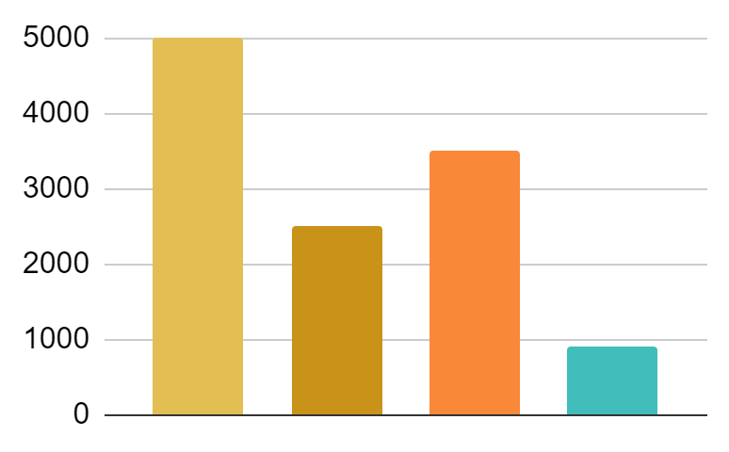
KPI INFOGRAPHICS
MERCURY
NEPTUNE
Mercury is the closest planet to the Sun
Neptune is the farthest planet from the Sun
MARS
JUPITER
Despite being red, Mars is a cold place
It's the biggest planet in the Solar System
22%
34%
46%
68%
Venus has a beautiful name. It’s hot
Saturn is the ringed planet. It’s a gas giant
The Sun is the star at the center
The Moon is a satellite. It orbits Earth

Slide 5
KPI INFOGRAPHICS
MERCURY
$30
90%
Mercury is the closest planet to the Sun
$60
$40
MARS
75%
Despite being red, Mars is a cold place
25%
50%
75%
Mercury
Mars
SATURN
NEPTUNE
50%
It's the closest one to the Sun
Mars is now a cold place
It's the only one with rings
Neptune is the farthest planet from the Sun

Slide 6
KPI INFOGRAPHICS
60%
10,000
8,000
4,000
10,000
40%
visitors
records
sales
products
20%
90%
MERCURY
NEPTUNE
70%
Mercury is the closest planet to the Sun
Neptune is the farthest planet from the Sun
50%
30%
MARS
JUPITER
Despite being red, Mars is a cold place
It's the biggest planet in the Solar System

Slide 7
KPI INFOGRAPHICS
Mars
Retail SALES INCREASE
INTERNET SALES INCREASE
Despite being red, Mars is a cold place
neptune
15%
22%
Neptune is the farthest planet from the Sun
11%
26%
Mercury
Mercury is the closest planet to the Sun
18%
20%
SATURN
90%
85%
36%
45%
It’s composed of hydrogen and also of helium
70%
60%

Slide 8
KPI INFOGRAPHICS
MERCURY
MARS
NEPTUNE
JUPITER
Mercury is the closest planet to the Sun
Despite being red, Mars is a cold place
Neptune is the farthest planet from the Sun
It's the biggest planet in the Solar System
01
02
03
04
50%
60%
40%
80%

Slide 9
KPI INFOGRAPHICS
% SALES
% NEW CUSTOMERS
% GOALS
25%
48%
78%
Mars
20%
Despite being red Mars is a cold place
neptune
30%
Neptune is the farthest planet from the Sun
Mercury
40%
Mercury is the closest planet to the Sun

Slide 10
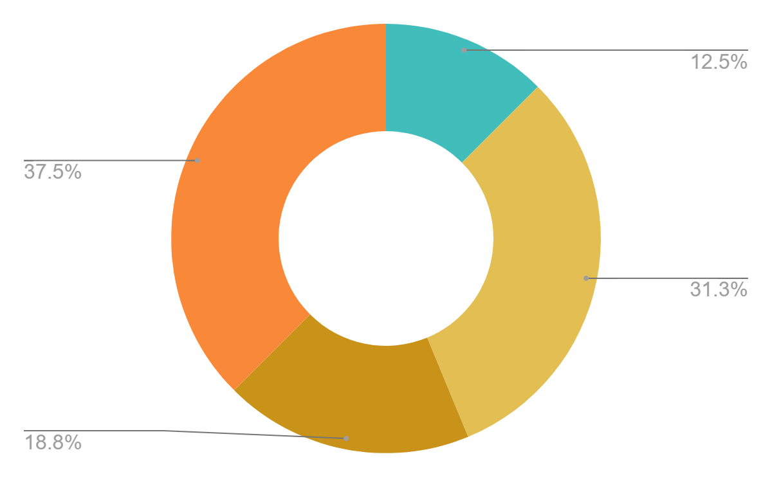
KPI INFOGRAPHICS
2019 | 2020
500 Units | 200 Units
1600 Units | 1300 Units
1000 Units | 1400 Units
2300 Units | 2600 Units
2700 Units | 3100 Units
3300 Units | 3900 Units
MERCURY
NEPTUNE
Mercury is the closest planet to the Sun
Neptune is the farthest planet from the Sun
MARS
JUPITER
Despite being red, Mars is a cold place
It's the biggest planet in the Solar System

Slide 11
KPI INFOGRAPHICS
90%
45%
60%
JUPITER
SATURN
NEPTUNE
Jupiter is a gas giant and the biggest one
Saturn is the only planet with rings
It´s the farthest planet of them all

Slide 12
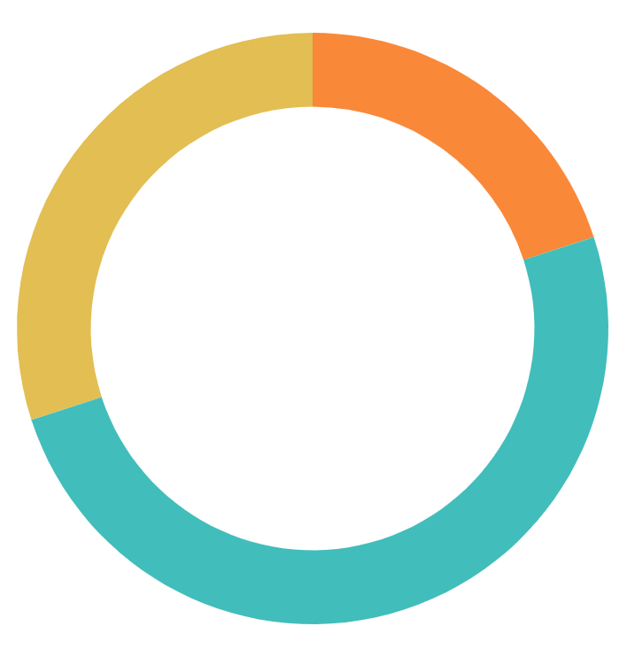
KPI INFOGRAPHICS
50%
20%
25%
30%
30%
50%
JUPITER
Mars
neptune
SATURN
PLUTO
Despite being red, Mars is a cold place
Neptune is the farthest planet from the Sun
It’s composed of hydrogen and helium
VENUS

Slide 13
KPI INFOGRAPHICS
MERCURY
VENUS
JUPITER
SATURN
Mercury is the closest planet to the Sun
Venus is the second planet from the Sun
Jupiter is the biggest planet of them all
Saturn is the ringed one and a gas giant
30%
39%
39%
39%

Slide 14
KPI INFOGRAPHICS
VENUS
Venus has a beautiful name and is the second one from the Sun
8,700
MERCURY
Mercury is the closest planet to the Sun and the smallest one
5,200
MARS
Despite being red, Mars is a cold place full of iron oxide dust
4,100
JUPITER
Jupiter is a gas giant and the biggest planet of all of them
7,600

Slide 15
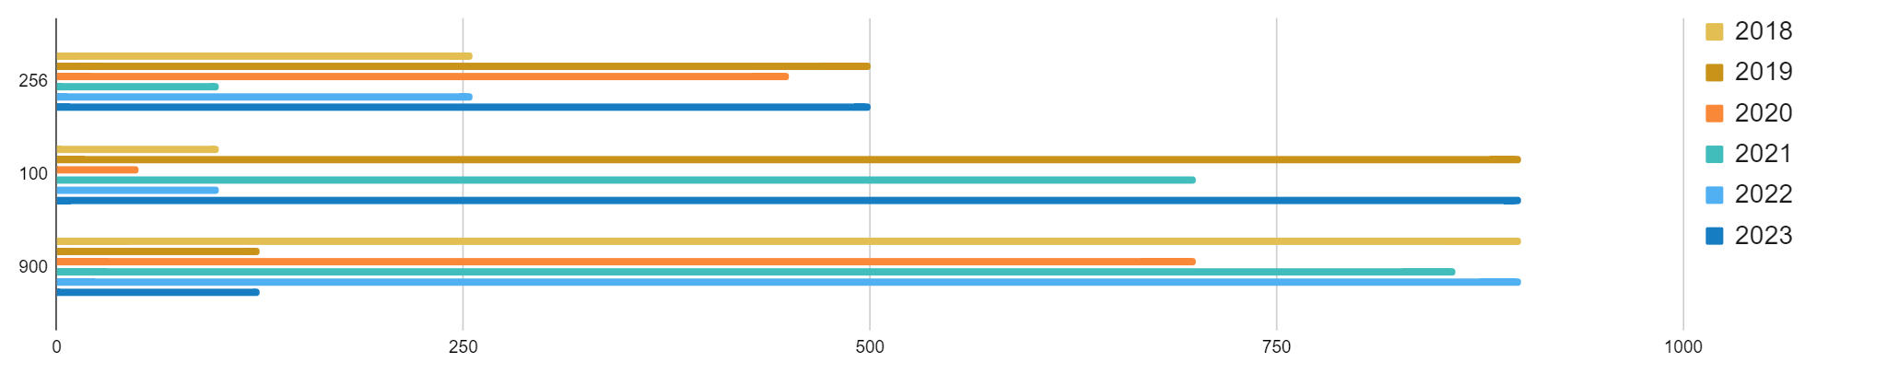
KPI INFOGRAPHICS
MERCURY
SATURN
JUPITER
20%
Mercury is the closest planet to the Sun
It’s the only one with rings of all of them
It's the biggest one in the Solar System
40%
30%
60%
MARS
NEPTUNE
VENUS
50%
Despite being red, Mars is a cold place
It’s the farthest one from the Sun
Venus has a beautiful name but It's very hot
80%

Slide 16
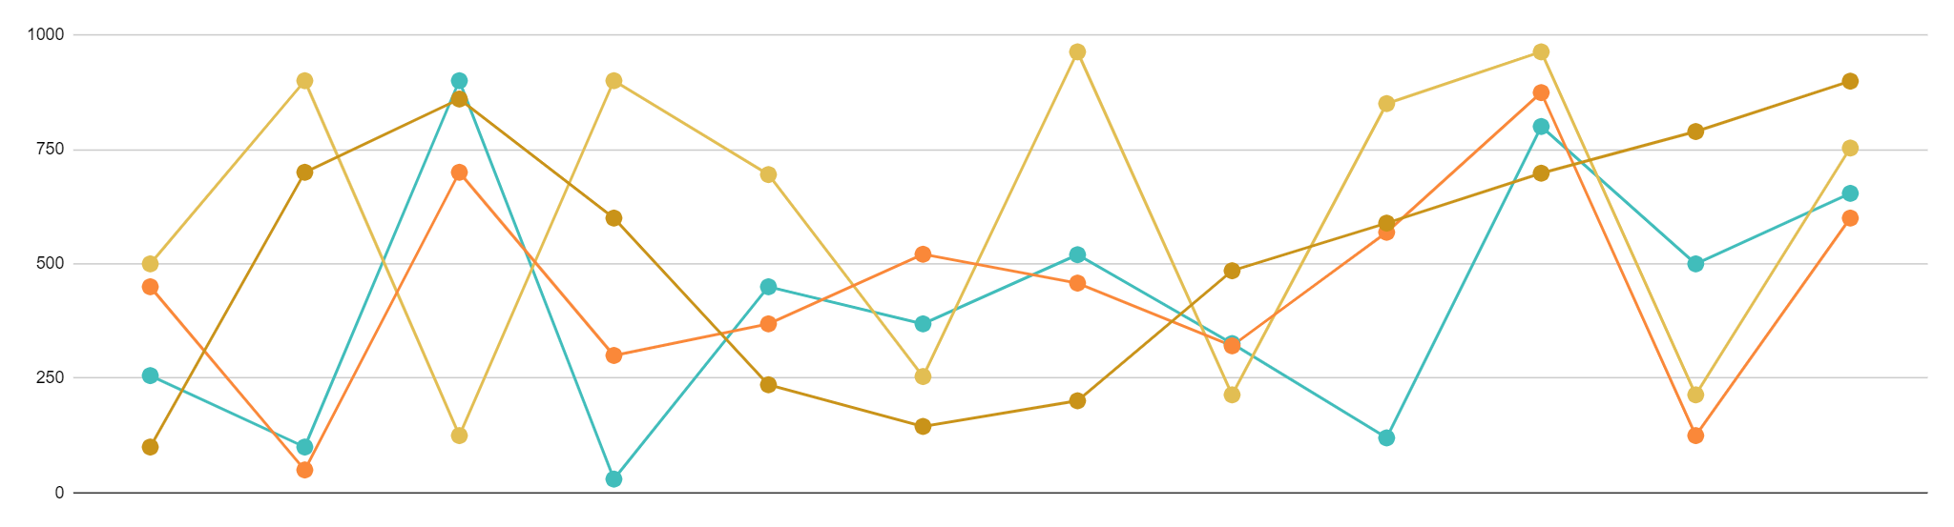
KPI INFOGRAPHICS
Jan
Feb
Mar
Apr
May
Jun
Jul
Aug
Sep
Oct
Nov
Dec
2018
2019
2020
2021
20%
40%
60%
80%
Mercury is the closest planet to the Sun
Venus is the second planet from the Sun
Jupiter is the biggest planet of them all
Saturn is the ringed one and a gas giant

Slide 17
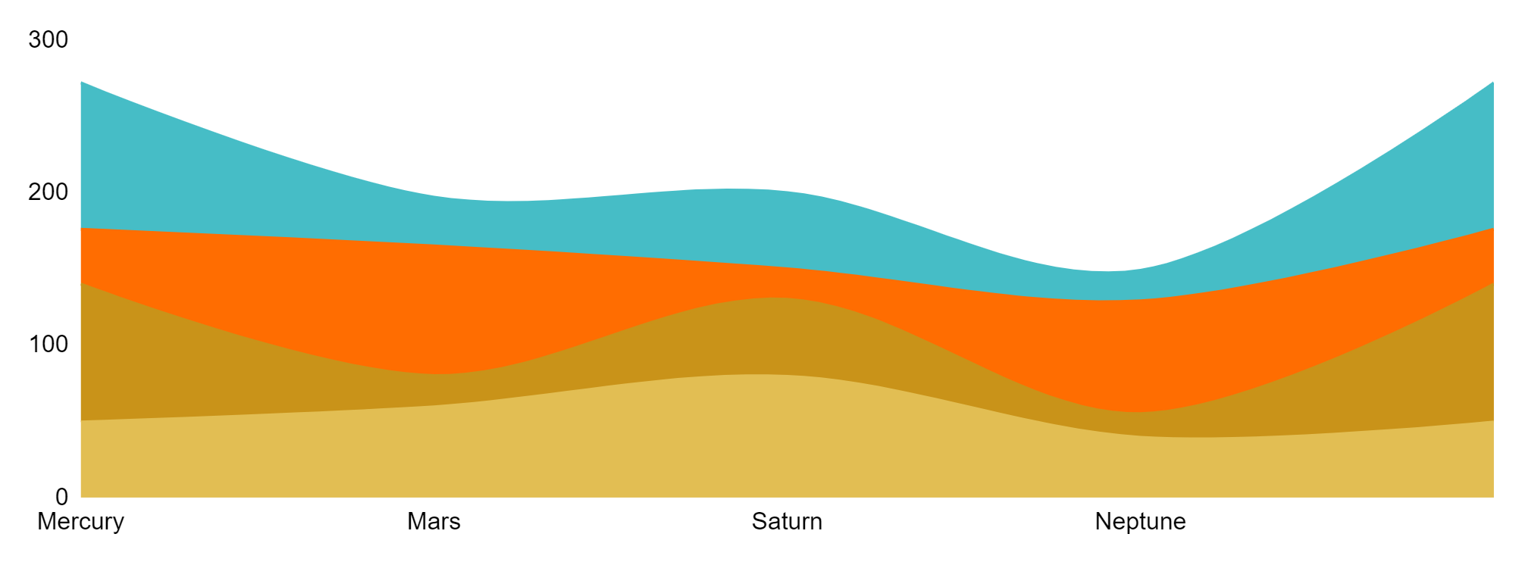
KPI INFOGRAPHICS
Mercury
saturn
Mercury is the closest planet to the Sun
It’s composed of hydrogen and helium
Mars
neptune
Despite being red, Mars is a cold place
Neptune is the farthest planet from the Sun
20%
50%
It's the biggest one in the Solar System
The Sun is the star at the center
20%
10%
Venus has a beautiful name but It's very hot
The Moon is a satellite. It orbits Earth

Slide 18
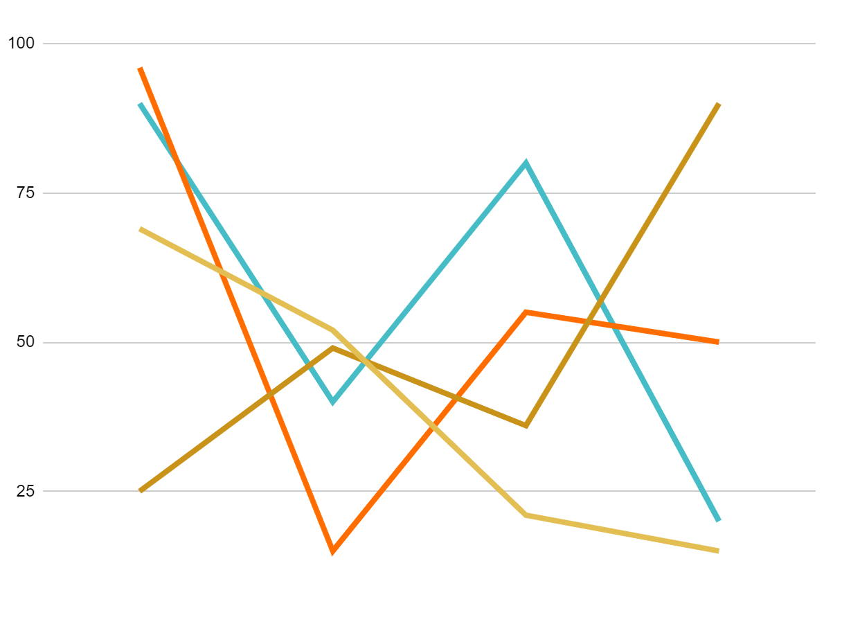
KPI INFOGRAPHICS
Mercury
saturn
Mercury is the closest planet to the Sun and the smallest one
It’s composed of hydrogen and helium and it has rings
20%
25%
Mars
neptune
Despite being red, Mars is actually a cold place full of iron dust
Planet Neptune is the farthest planet from the Sun of all of them
40%
15%

Slide 19
KPI INFOGRAPHICS
25%
50%
80%
90%
Mercury
Mercury is also the closest planet to the Sun
Mars
Despite being red, Mars is a cold place
SATURN
It’s composed of hydrogen and also of helium
VENUS
Venus has a beautiful name but It's terrible hot

Slide 20
KPI INFOGRAPHICS
Mercury
saturn
venus
40%
40%
80%
Mercury is the closest planet to the Sun
It’s composed of hydrogen and of helium
Venus has a beautiful name but It's very hot
Mars
neptune
jupiter
60%
60%
70%
Despite being red, Mars is a cold place
Neptune is the farthest planet from the Sun
It's the biggest planet in the Solar System
100,000
$100,000.00

Slide 21
KPI INFOGRAPHICS
A
18%
MERCURY
B
C
92%
MARS
D
83%
saTURN
MERCURY
SATURN
Mercury is the closest planet to the Sun
It’s composed of hydrogen and of helium
MARS
NEPTUNE
77%
NEPTUNE
Despite being red, Mars is a cold place
Neptune is the farthest planet from the Sun
100,000
$100,000.00

Slide 22
KPI INFOGRAPHICS
% SALES
% NEW CUSTOMERS
% GOALS
% average
55%
74%
67%
89%
Mars
SATURN
Despite being red, Mars is a cold place
It’s composed of hydrogen and helium
MERCURY
VENUS
Mercury is the closest planet
Venus has a beautiful name
100,000
$100,000.00

Slide 23
KPI INFOGRAPHICS
MERCURY
Mercury is the closest planet to the Sun
MARS
Despite being red, Mars is a cold place
SATURN
It’s composed of hydrogen and helium
NEPTUNE
It’s the farthest one from the Sun
22%
36%
12%
30%
100,000
$100,000.00

Slide 24
KPI INFOGRAPHICS
NEPTUNE
Jupiter
Neptune is the farthest planet from the Sun
Jupiter is the biggest planet of them all
Saturn
Mars
It’s composed of hydrogen and helium
Despite being red, Mars is actually a cold place
Saturn is the ringed planet
Pluto is an icy dwarf planet
Venus has a beautiful name
15%
25%
60%
100,000
$100,000.00

Slide 25
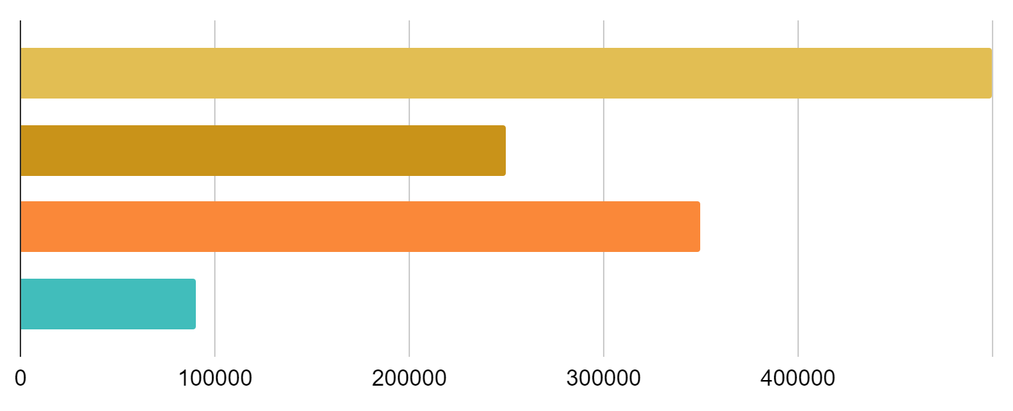
KPI INFOGRAPHICS
NEPTUNE
MERCURY
Neptune is the farthest
It’s the closest planet
JUPITER
MARS
It's the biggest planet
Mars is a cold place
40%
MERCURY
Mercury is the closest planet to the Sun and the smallest one
70%
MARS
Despite being red, Mars is a cold place full of iron oxide dust
80%
JUPITER
Jupiter is a gas giant and the biggest planet of all of them
20%
VENUS
Venus has a beautiful name and is the second one
99%
Saturn
Saturn is a gas giant and has several rings
A
B
C
D
E
100,000
$100,000.00

Slide 26
KPI INFOGRAPHICS
75%
100%
50%
25%
% SALES
% NEW CUSTOMERS
% GOALS
% average
+12
+24
+39
+33
MERCURY
SATURN
MARS
VENUS
Mercury is the closest planet to the Sun
Saturn is a gas giant and has several rings
Despite being red, Mars is a cold place
Venus is the second planet from the Sun
100,000
$100,000.00

Slide 27
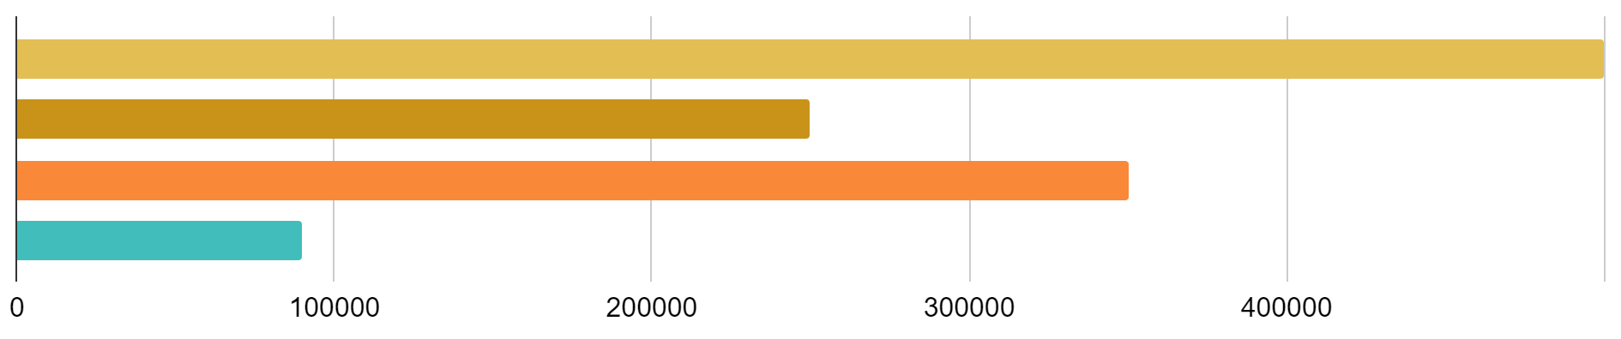
KPI INFOGRAPHICS
Mercury
saturn
Mercury is the closest planet to the Sun
It’s composed of hydrogen and helium
Mars
neptune
Despite being red, Mars is a cold place
Neptune is the farthest planet from the Sun
60%
18%
26%
70%
100,000
$100,000.00

Slide 28
KPI INFOGRAPHICS
50%
Venus
Mars
Venus has a beautiful name and is the second one
Despite being red, Mars is also a cold place
35%
10%
15%
Mercury
Jupiter
Mercury is the closest planet to the Sun
Jupiter is a gas giant and the biggest planet
100,000
$100,000.00

Slide 29
KPI INFOGRAPHICS
Mars
Despite being red Mars is a cold place
neptune
Neptune is the farthest planet from the Sun
90%
70%
40%
75%
80%
60%
60%
85%
100%
2020
2021
2022
Mercury
Venus is the second planet from Sun
Mars is a cold place full of iron oxide dust
Saturn is a gas giant and has several rings
Mercury is the closest planet to the Sun
100,000
$100,000.00

Slide 30
KPI INFOGRAPHICS
MERCURY
VENUS
Mercury is the closest planet to the Sun
Venus has a beautiful name but It's very hot
MARS
JUPITER
Despite being red, Mars is a cold place
It's the biggest planet in the Solar System
SATURN
NEPTUNE
It’s composed of hydrogen and of helium
Neptune is the farthest planet from the Sun
100,000
$100,000.00

Slide 31
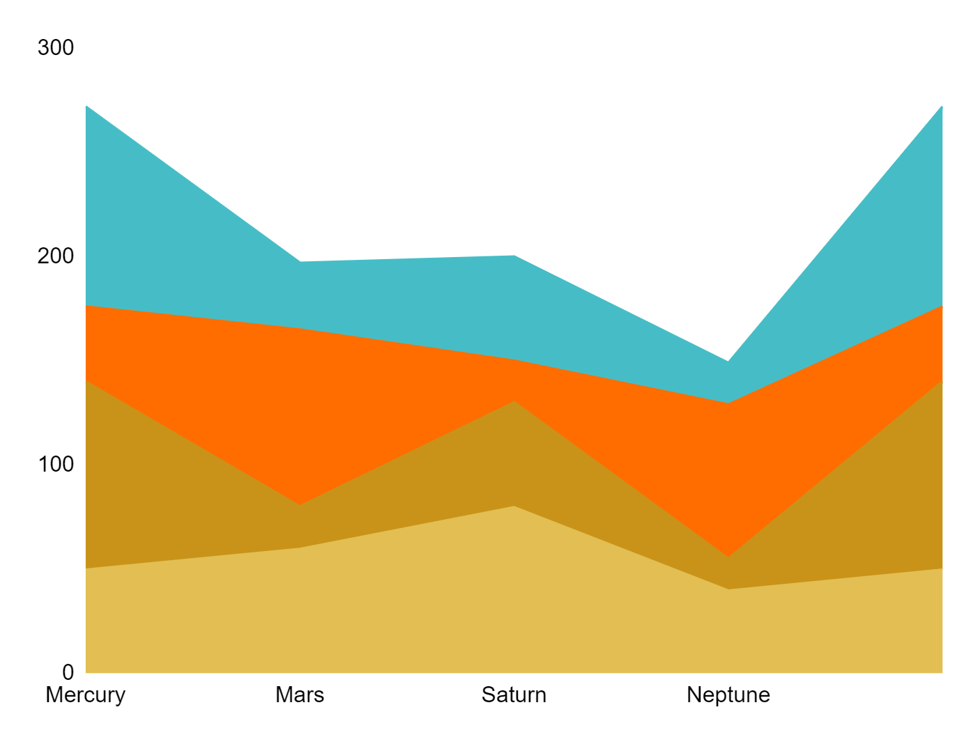
KPI INFOGRAPHICS
KPI INFOGRAPHICS
VENUS
Venus has a beautiful name and is the second one from the Sun
MERCURY
Mercury is the closest planet to the Sun and the smallest one
MARS
Despite being red, Mars is a cold place full of iron oxide dust
JUPITER
Jupiter is a gas giant and the biggest planet of all of them
100,000
$100,000.00

Slide 32
Instructions for use
In order to use this template, you must credit Slidesgo and Freepik in your final presentation and include links to both websites.
You are allowed to:
- Modify this template.
- Use it for both personal and commercial projects.
You are not allowed to:
- Sublicense, sell or rent any of Slidesgo Content (or a modified version of Slidesgo Content).
- Distribute Slidesgo Content unless it has been expressly authorized by Slidesgo.
- Include Slidesgo Content in an online or offline database or file.
- Offer Slidesgo templates (or modified versions of Slidesgo templates) for download.
- Acquire the copyright of Slidesgo Content.
For more information about editing slides, please read our FAQs or visit Slidesgo School:
https://slidesgo.com/faqs and https://slidesgo.com/slidesgo-school

Slide 33
Infographics
You can add and edit some infographics to your presentation to show your data in a visual way.
Choose your favourite infographic and insert it in your presentation using Ctrl C + Ctrl V or Cmd C + Cmd V in Mac.
Select one of the parts and ungroup it by right-clicking and choosing “Ungroup”.
Change the color by clicking on the paint bucket.
Then resize the element by clicking and dragging one of the square-shaped points of its bounding box (the cursor should look like a double-headed arrow). Remember to hold Shift while dragging to keep the proportions.
Group the elements again by selecting them, right-clicking and choosing “Group”.
Repeat the steps above with the other parts and when you’re done editing, copy the end result and paste it into your presentation.
Remember to choose the “Keep source formatting” option so that it keeps the design. For more info, please visit Slidesgo School.

